Slide 1
Network-Accelerator Co-Design for Dynamic Inference of Natural Language Processing
宋玉红
2020.07.26

Slide 2
Motivation
Challenges:
When transformer comes to edge, directly deploying transformer to device will consume excessive energy.
The edge device has limitation with dynamically changed energy budget(e.g. battery).
Solutions:
Compress model from a hot start
Neural network models need to adapt to the fluctuating energy budget, we propose a dynamic inference for transformer.

Slide 3
Outline
Accuracy Driven Pre-compression
Hardware-Aware Re-compression
Tradeoff between energy and accuracy with latency constraint
Fine-tune for best shared weight to switch different pruning mask in hardware directly
Use reinforcement learning for searching best mask set

Slide 4
Accuracy Driven Pre-compression
Accuracy Driven Pre-compression
Use block pruning to pre-train a good model
Guaranteed accuracy
Certain sparsity ratio
Certain block size
Certain transformer architecture
Encoder and decoder
Embedding dimension
Hidden dimension
Head number
Layer number
And certain dataset
Notes:
需要协商确定好的内容

Slide 5
Hardware-Aware Re-compression
Objectives
Given time constraint
Select a set of weight masks
Trade off energy and accuracy to switch different situations
For example,
Latency | Energy | Accuracy
10ms | 100J | 99%
9ms | 90J | 98%
9ms | 80J | 97.5%
9ms | 70J | 97%
8ms | 60J | 96%
Notes:
问题：energy如何表示？直接与sparsity ratio相关？

Slide 6
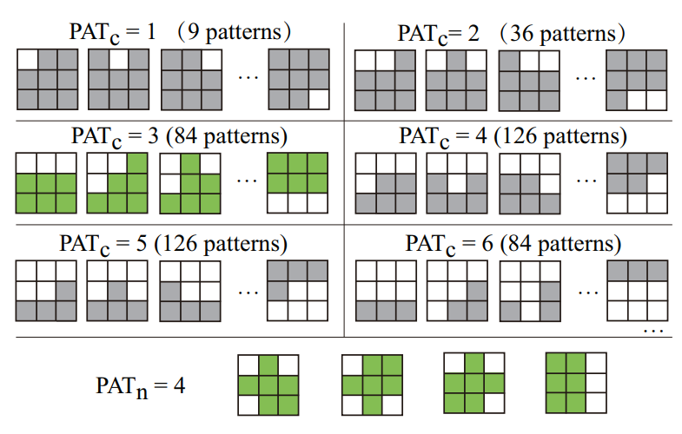
Hardware-Aware Re-compression
Mask example
Notes:
问题：对不同的block应用不同的pattern（来自同一个mask），会不会对energy有影响？

Slide 7
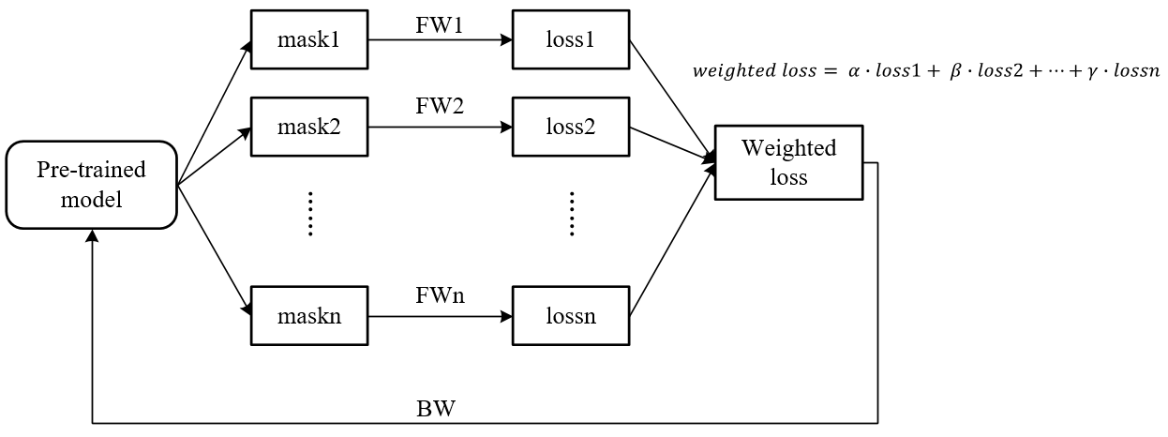
Hardware-Aware Re-compression
Fine-tune for best shared weight
For switching weight masks in different situations, different weight masks need to use shared weight
Fine-tune in pre-trained model
How to obtain the best shared weight for different masks?

Slide 8
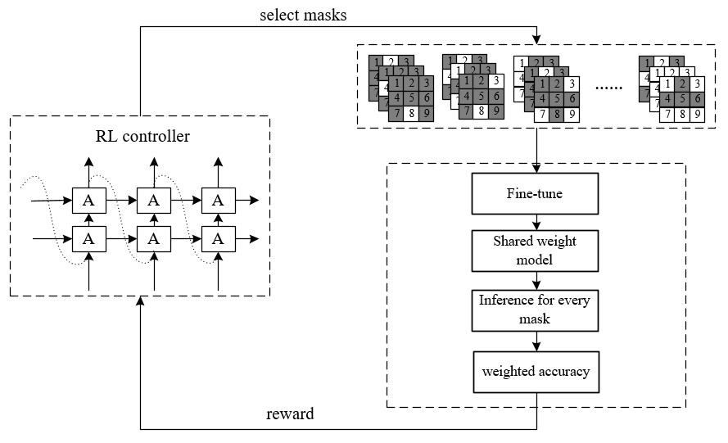
Hardware-Aware Re-compression
Overview

Slide 9
Hardware-Aware Re-compression
Overview

